Slide 1
Fundamentals of Nursing(1st Stage)
Safety and Activity
(Theory)
Lecture 3
University of Basrah –College of Nursing – Fundamentals of Nursing Department

Slide 2
Introduction
Safety or freedom from danger, harm, or risk—is a paramount concern that underlies all nursing care. In addition, patient safety is a responsibility of all health care providers
University of Basrah-College of Nursing– Fundamentals of Nursing Department

Slide 3
FACTORS AFFECTING SAFETY
Promoting safety and preventing injury are dual responsibilities of the nurse. Being aware of factors that affect safety, such as:
Developmental level
Life style
Mobility
Sensory perception
University of Basrah-College of Nursing– Fundamentals of Nursing Department

Slide 4
5- Knowledge level
6- Communication ability
7- Physical health state
8- Psychosocial state allows nurses to identify potential hazards and promote wellness
University of Basrah-College of Nursing– Fundamentals of Nursing Department

Slide 5
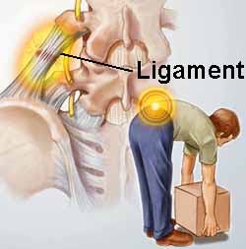
Body Mechanics
Body mechanics is the use of proper body positions to provide protection from the stress of movement and activity, specifically in regard to structure, function, and position of the body
University of Basrah-College of Nursing– Fundamentals of Nursing Department

Slide 6
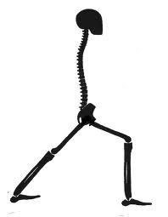
Body mechanics
Correct positioning of the body for a given task. Proper body movement to prevent and correct posture problems.
University of Basrah-College of Nursing– Fundamentals of Nursing Department

Slide 7
Rules of Body Mechanics
Provide a broad base of support
Work at a comfortable height
When lifting, bend your knees and keep your back straight
Keep your load well balanced and close to your body
Roll or push a heavy object. Avoid pulling or lifting
University of Basrah-College of Nursing– Fundamentals of Nursing Department

Slide 8
3 Major Concepts
Base of support: The portion of the body in contact with the floor.
2) Broad base = stability
3)Center of body weight: the point around which body weight is balanced.
Usually located in the mid portion of the pelvis or lower abdomen, depending on body build.
Any object your hold adds to the weight on the base of support… affecting the location of your center of gravity.
University of Basrah-College of Nursing– Fundamentals of Nursing Department

Slide 9
Ergonomics
The science of designing equipment and devices that fit the human body and its movements
University of Basrah-College of Nursing– Fundamentals of Nursing Department

Slide 10
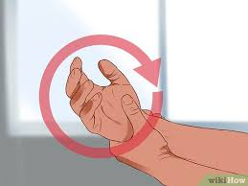
Repetitive Motion Injury (RMI)
Overuse of one body part
Repetitive task
Forceful exertion
Awkward position
University of Basrah-College of Nursing– Fundamentals of Nursing Department

Slide 11
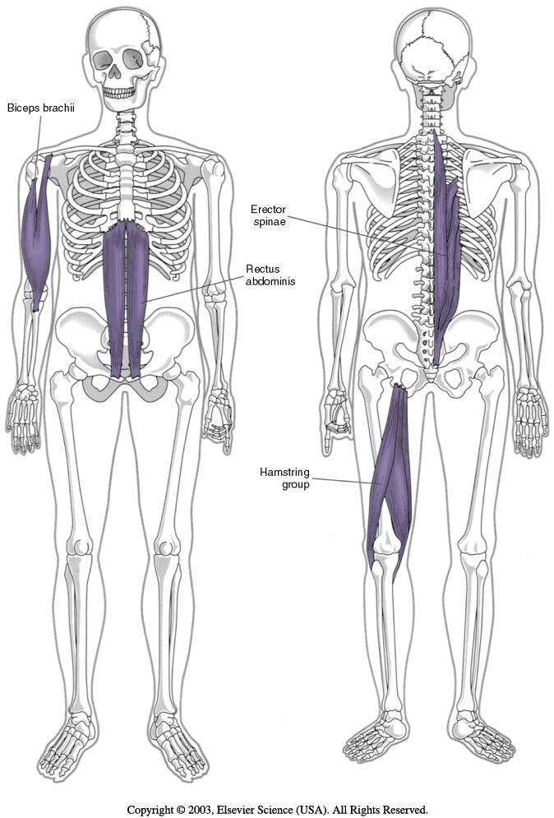
Strained Muscles
Most common among hospital workers
Reported by radiographers
University of Basrah-College of Nursing– Fundamentals of Nursing Department

Slide 12
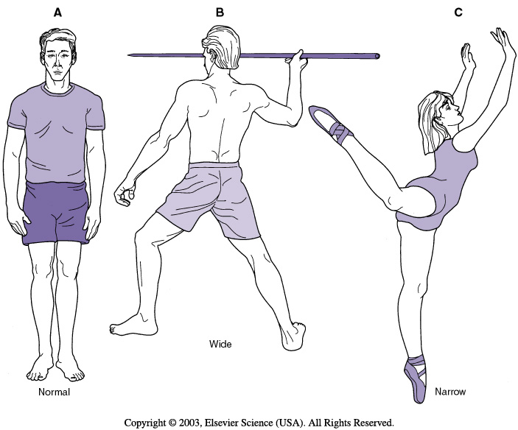
University of Basrah-College of Nursing– Fundamentals of Nursing Department

Slide 13
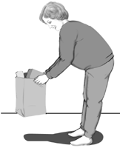
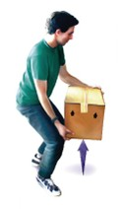
Line of Gravity
Good
Imaginary vertical line passing through the center of gravity.
The body is most stable when the line of gravity bisects the base of support
Not good
University of Basrah-College of Nursing– Fundamentals of Nursing Department

Slide 14
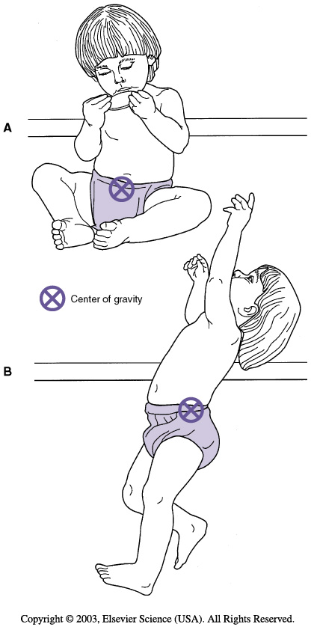
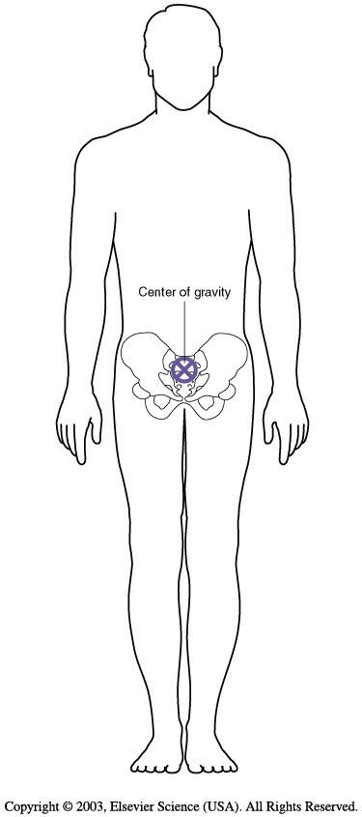
Center of gravity for most people is S 2
University of Basrah-College of Nursing– Fundamentals of Nursing Department

Slide 15
Preparing for Safe Patient Transfer
Enlist the patient’s help and cooperation.
Tell the patient what you are doing as you proceed
Obtain additional help when necessary.
Check to make certain your assistants understand their role in the transfer
University of Basrah-College of Nursing– Fundamentals of Nursing Department

Slide 16
Wheelchair Transfers
To get started lower the patients bed as far as it will go and raise the head.
Support the patients head and knees.
Lift and rotate the patient to a sitting position with their legs hanging over the edge of the bed.
Help the patient with slippers and robe.
University of Basrah-College of Nursing– Fundamentals of Nursing Department

Slide 17
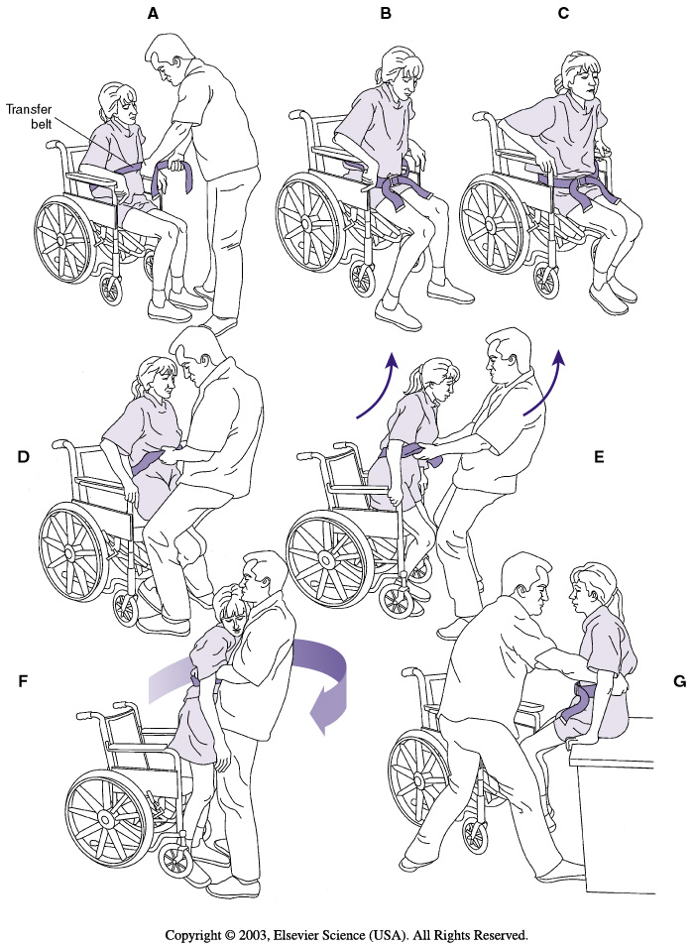
This will allow patient time to regain a sense of balance.
At this point some patient will be able to stand and get to the wheelchair on their own.
Transfer from Bed or Chair
University of Basrah-College of Nursing– Fundamentals of Nursing Department

Slide 18
Goals of Bed and Wheelchair Positioning
• Refer to the team to develop a positioning plan that everyone follows
• Maintain skin integrity and circulation
• Comfort and neutral body alignment
• Reduce the development of contractures
• Maintain a functional position
University of Basrah-College of Nursing– Fundamentals of Nursing Department

Slide 19
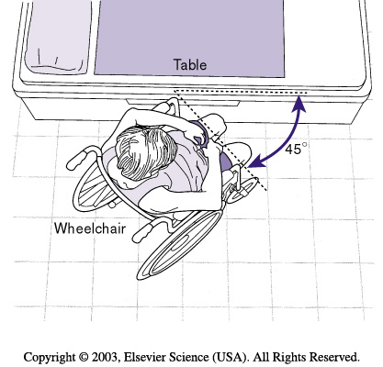
University of Basrah-College of Nursing– Fundamentals of Nursing Department

Slide 20
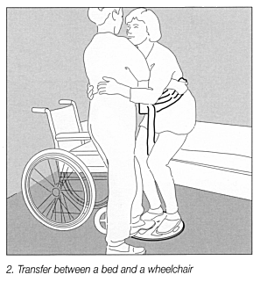
University of Basrah-College of Nursing– Fundamentals of Nursing Department

Slide 21
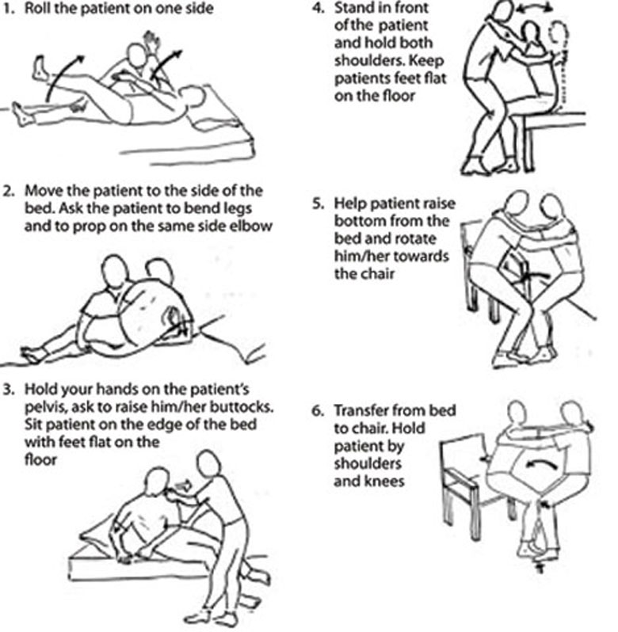
University of Basrah-College of Nursing– Fundamentals of Nursing Department

Slide 22
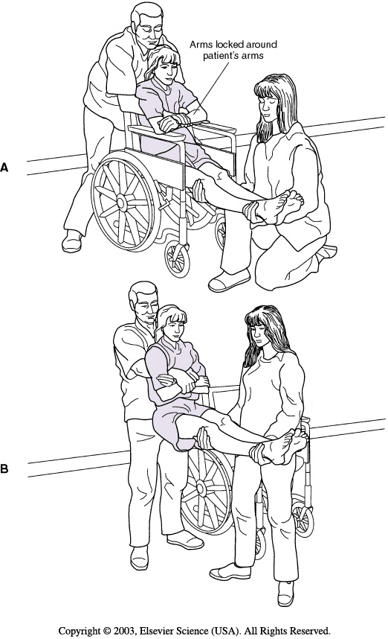
Two person transfer
When patient too weak, too unsteady or otherwise unable to move safely, he need the help of two trained caregivers to change position.
University of Basrah-College of Nursing– Fundamentals of Nursing Department

Slide 23
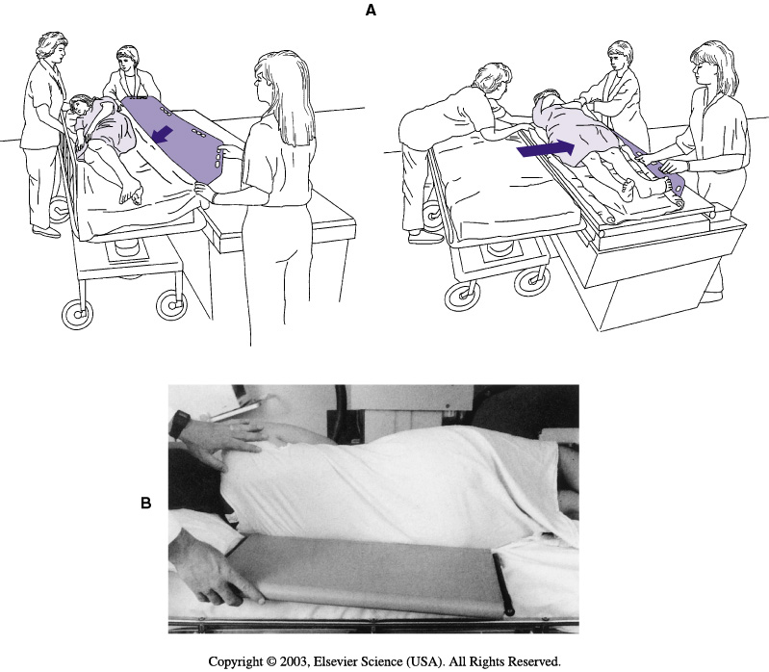
Bed and stretcher transfers
Bed to stretcher transfer requires a minimum of three to four people, depending on the size of the patient and the size and strength of the health care providers. Patients who require this type of transfer are generally immobile or acutely ill and may be unable to assist with the transfer.
University of Basrah-College of Nursing– Fundamentals of Nursing Department

Slide 24
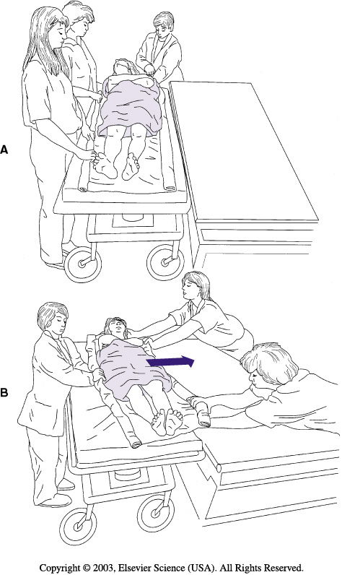
University of Basrah-College of Nursing– Fundamentals of Nursing Department

Slide 25
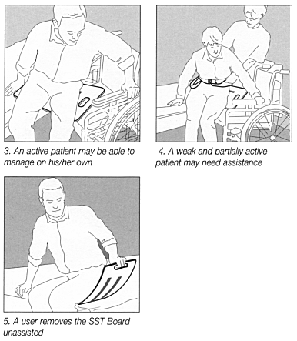
Transferring with a slide board
Sliding board is a piece of equipment that can be used if a person is not able to use their legs to complete a transfer between surfaces or if a standing transfer is not safe to perform. The board is used to make a solid “bridge” between the two surfaces that a person can slide across to transfer between them.
University of Basrah-College of Nursing– Fundamentals of Nursing Department

Slide 26
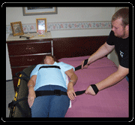
Tools for moving Patients
University of Basrah-College of Nursing– Fundamentals of Nursing Department

Slide 27
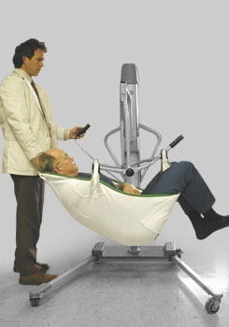
Mechanical lift devices
Mechanical lift devices: are used to move those who are unable to stand on their own or whose weight makes it unsafe to move or lift them manually.
Move slowly while doing a lift transfer to keep the patient stable and safe.
University of Basrah-College of Nursing– Fundamentals of Nursing Department

Slide 28
Nursing diagnosis
Activity Intolerance
Impaired Physical Mobility
Self care deficit
Risk for Injury
University of Basrah-College of Nursing– Fundamentals of Nursing Department

Slide 29
Nursing care plan
1- Assess the patient. Know the patient’s medical diagnosis, capabilities, and any movement not allowed. Apply braces or any device the patient wears before helping from bed.
2- Eliminate unnecessary tasks to reduce the risk of injury and increase the patient’s self-esteem and mobility levels.
University of Basrah-College of Nursing– Fundamentals of Nursing Department

Slide 30
3- Assess the patient’s ability to understand instructions and cooperate with the staff to achieve the movement.
4- Use an assessment tool to aid in patient assessment and decision-making regarding safe patient handling and movement.
5- During any patient-transferring task, if any caregiver is required to lift more than 35 pounds of a patient’s weight, consider the patient to be fully dependent and use assistive devices for the transfer.
University of Basrah-College of Nursing– Fundamentals of Nursing Department

Slide 31
6- Ensure that enough staff is available and present to safely move the patient.
7- Assess the area for clutter, accessibility to the patient, and availability of devices.
8- Remove any obstacles that may make moving and lifting inconvenient.
9- Decide which equipment to use. Step-by-step protocols or algorithms are available to aid decision making to prevent injury to staff and patients.
10- Use handling aids, transfer equipment, and assistive devices whenever possible to help reduce risk of injury to yourself and the patient.
.
University of Basrah-College of Nursing– Fundamentals of Nursing Department

Slide 32
Thanks
University of Basrah –College of Nursing– Fundamentals of Nursing Department

